Slide 1
Commission
Year 11
Week 1
Lesson 4

Slide 2
Topic: Commission
Date
EQ – How to find the commission percentage earned
Can you remember:
How to express an amount as a percentage of a total amount?
Finding a percentage of something
Express each of the following as a percentage
18 students out of a total of 40 students
$3.60 out of $45.00

Slide 3
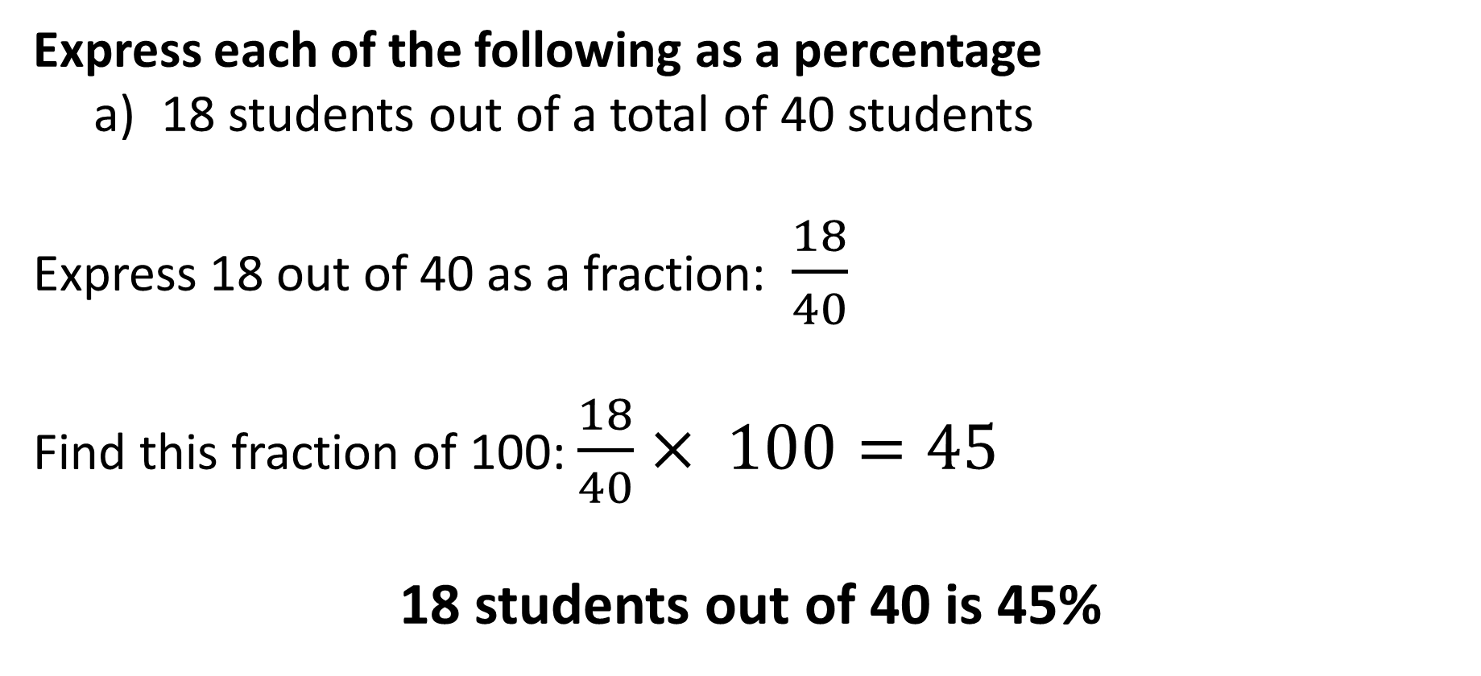
Topic: Commission
Date
EQ – How to find the commission percentage earned
Express each of the following as a percentage
18 students out of a total of 40 students
Express 18 out of 40 as a fraction: $\frac{18}{40}$
Find this fraction of 100: $\frac{18}{40}× 100=45$
18 students out of 40 is 45%

Slide 4
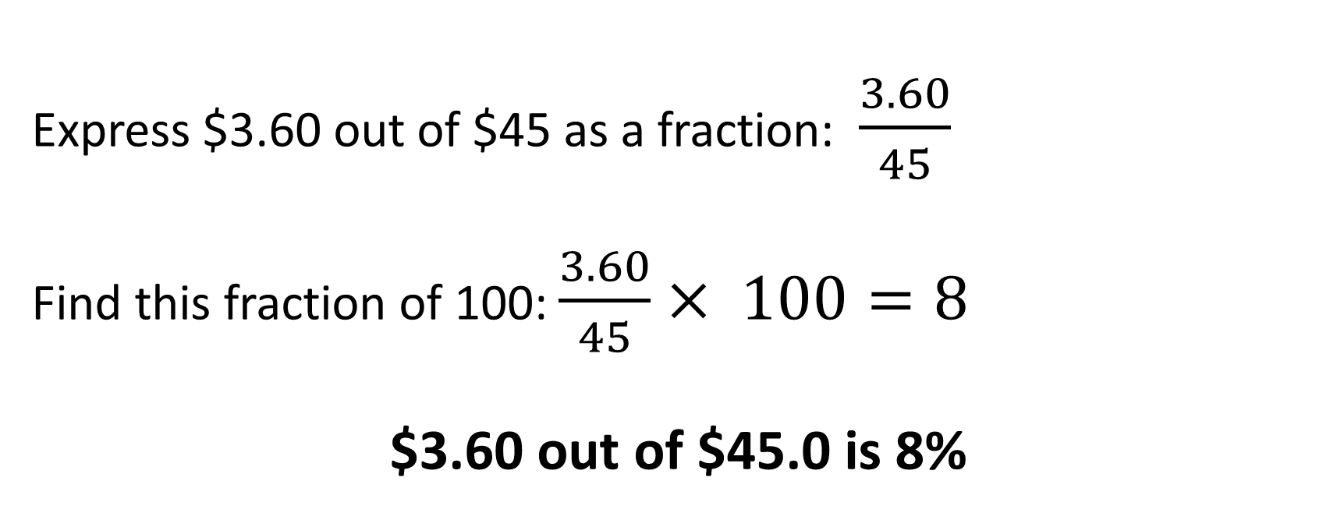
Topic: Commission
Date
EQ – How to find the commission percentage earned
Express each of the following as a percentage
$3.60 out of $45.0
Express $3.60 out of $45 as a fraction: $\frac{3.60}{45}$
Find this fraction of 100: $\frac{3.60}{45}× 100=8$
$3.60 out of $45.0 is 8%

Slide 5

Topic: Commission
Date
EQ – How to find the commission percentage earned
Increase $450 by 24%
Express 24% as a fraction: $\frac{24}{100}$
Find this fraction of 450: $\frac{24}{100}×450=108$
Increase $450 + $108 = $558
$450 increased by 24% is $558

Slide 6
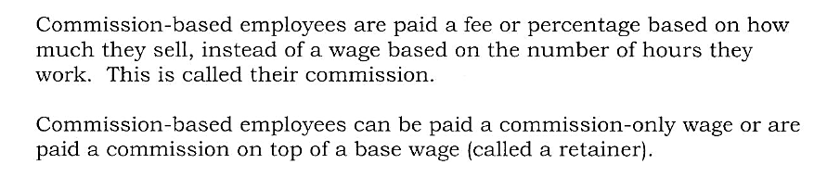
Topic: Commission
Date
EQ – How to find the commission percentage earned

Slide 7
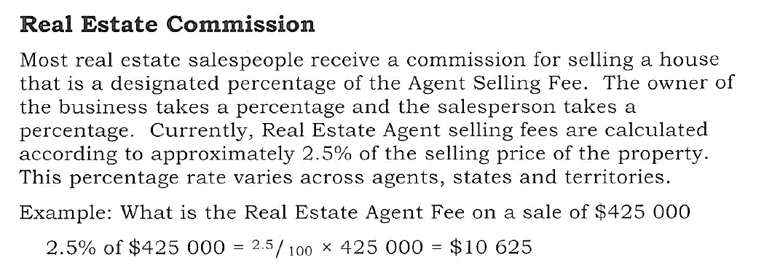
Topic: Commission
Date
EQ – How to find the commission percentage earned

Slide 8
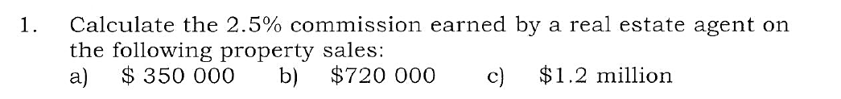

Slide 9
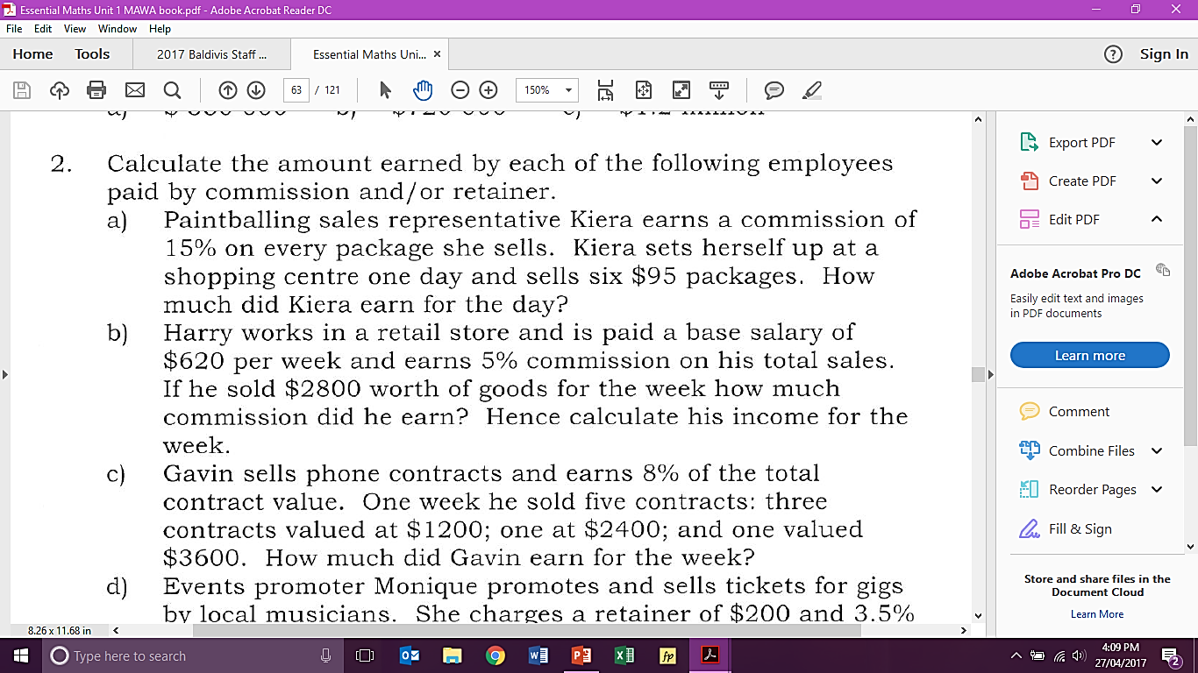

Slide 12
